Slide 1
Introduction to Freelancing

Slide 2
Agenda
What is a freelancer?
How to Become a Freelancer
Available Platforms
Create a Profile

Slide 3

What is a freelancer?

Slide 4
What is a freelancer?
A freelancer is a self-employed individual who offers services to a company or Individuals.
Freelancers can take on as much work from as many businesses as they please. Ultimately, their career and workload are in their own hands.
Freelancers are most common in creative industries like
Graphic design, Copywriting and photography.
However, service-based industries offer a ton of opportunities for freelancers as well.
The freelance process typically goes as follows:
The freelancer reaches out to clients/vice versa for possible contract work.
The freelancer tackles projects at a set price, such as per project or per hour.
The client pays the freelancer for work; taxes are not taken out of paycheck and freelancers must pay quarterly taxes.

Slide 5
What are Pros & Cons of being freelancer?
Some of the benefits include the ability to decide the work you want to take on and the control over how you spend your time.
There are always work opportunities:
You control your schedule:
You have an amazing opportunity to gather experience:
You choose whom you work with:
What are the drawbacks of freelancing?
The freelancer reaches out to clients/vice versa for possible contract work.
You need discipline and routine:
Sometimes, there won’t be work:
Sometimes, you’ll work longer hours:
It can take a while to get your first gig:

Slide 6

How to Become a Freelancer

Slide 7
How to Become a Freelancer
Step 1: Consider whether freelancing is for you.
Step 2: Find a platform.
Step 3: Build your profile.
Step 4: Build your portfolio.
Step 5: Determine your price.
Step 6: Find work.
Step 7: Focus on client relationships.

Slide 8
Step 1: Consider whether freelancing is for you.
Some of the benefits include the ability to decide the work you want to take on and the control over how you spend your time.
Being your own boss is a great thing if you’re disciplined and reliable.
Freelancing enables you to set your schedule, so you can take a day off whenever you want,
You won’t be paid for that time because there is no such thing as paid leave.
If you want to be a freelancer, you should maintain a daily work routine.
Be ready to juggle several assignments at once and continually look for new projects to maintain a steady flow of work.
If you’re still working full time, don’t immediately quit your job.
Instead, combine freelancing and full-time work until you accumulate enough clients and connections to support yourself as a freelancer

Slide 9
Step 2: Find a Platform.
Some of the benefits include the ability to decide the work you want to take on and the control over how you spend your time.
Choosing the platform with the model that fits your needs and salary expectations is incredibly important for your success.
For example, there are numerous highly rated freelance websites for finding developers.
Plenty of freelancing websites encourage the so-called “race to the bottom,” where freelancers provide poor quality work in exchange for poor compensation.
Ultimately, it doesn’t help anyone — buyers cannot find good quality of work and freelancers cannot earn enough money.
We will discuss the all the available platforms in the later section.

Slide 10
Step 3: Build your profile.
You don’t have to prepare a classical resume.
Most freelancing websites have a predesigned template you need to fill out with your information
but you shouldn’t treat your freelancing profile as a check box exercise.
Take time to create a substantial profile.
That will inform potential clients about your
Education, Skills, Expertise and Experience.
You don’t have to write novels — keep it concise. List your skills, experiences, special achievements and explain why you’re the best person for the job.

Slide 11
Step 4: Build your portfolio.
Your profile may state that you’re an astronaut,
Unless you upload your selfie from the international space station, potential clients are unlikely to believe you.
So, when you create a profile, make sure to provide a portfolio that illustrates your skills and experience.
If you’re a beginner in your chosen field, take time to create a portfolio.
With sample works or accept several jobs at a discounted rate in exchange for experience.

Slide 12
Step 5: Determine your price.
While your hourly rate or project price heavily depends on your skill set and experience.
If you have only a couple of years of experience, of course, you cannot charge the same rate as freelancers with a decade of work under their belts.
However, if you eventually want to turn freelancing into a full-time job, the rate should cover your monthly expenses.
If you have steady work, no matter how experienced you are. Consider a top credit card processing solution to help process client payments easily and efficiently.

Slide 13
Step 6: Find work.
First, apply only for the jobs you are confident you can do.
There is no point in applying for a project you cannot complete on time with satisfactory results.
As a freelancer, you’re building your reputation from scratch and, especially in the beginning, it’s of utmost importance to secure positive feedback.
When you apply for jobs, make sure you craft a relevant cover letter that explains why you’re the best choice for that particular job or project.
Highlight the skills and experience that are relevant to requirements.
Over time, freelancing platforms reward top-rated freelancers with badges, lower fees and access to specially tailored job offers, so it’s in your best interest to keep your clients happy.
Try to use various groups on Facebook and LinkedIn to find work. However, be aware that with these gigs, there is no contract in place and no guarantee that someone won’t take your work and never pay for it.

Slide 14
Step 7: Focus on client relationships.
Growing and sustaining your client relationships is the most important part of freelancing.
By maintaining a good connection with your current clients and providing quality work, you’ll be more likely to secure more consistent jobs in the future.
Make sure you meet every deadline, listen to instructions, make any necessary edits and communicate efficiently with your clients.
While you aren’t tied down to set hours, you should still be available to your clients in case they have any questions, requests or concerns.
Additionally, you’ll want to build your portfolio to attract new clients.
A good reputation is crucial as a freelancer, so make sure you are delivering your best work. In an age where online reviews are critical, you want to make sure you maintain the highest rating possible.
You can advertise your services on social media and on your website, which should be updated regularly.
A strong digital presence is critical as clients want to feel like they can trust you and your brand before working with you.

Slide 15
Available Platforms

Slide 16
Freelancing Platforms:
Platform | Description
Upwork | A large platform offering various categories of freelance work, including writing, design, and development.
Fiverr | A marketplace for freelancers to offer services starting at $5, suitable for creative and technical tasks.
Freelancer | Connects employers and freelancers globally for projects ranging from small tasks to large contracts.
Toptal | Focuses on connecting businesses with top-tier freelancers, particularly developers, designers, and finance experts.
PeoplePerHour | A UK-based platform for hiring professionals for hourly or project-based tasks across diverse fields.
Guru | Offers freelancers opportunities in multiple fields with a focus on secure payments and workrooms.
99designs | Specializes in connecting clients with designers for logos, branding, and graphic design projects.
SimplyHired | A job search engine that also lists freelance, remote, and contract-based opportunities.
Outsourcely | Focuses on remote work opportunities for startups and small businesses seeking long-term collaborations.
TaskRabbit | Specializes in local, on-demand freelance services like furniture assembly, moving, and home repairs.
We Work Remotely | A platform for remote freelance jobs, focusing on roles in development, design, writing, and more.
Hubstaff Talent | A free resource to connect freelancers with clients worldwide, offering a variety of roles.
Behance | A creative platform where designers and artists can showcase portfolios and find freelance opportunities.
Dribbble | Similar to Behance, focused on graphic designers, illustrators, and UI/UX professionals.
Workana | Popular in Latin America, offering freelance jobs in design, development, marketing, and writing.
CodementorX | Focused on software development and programming projects, connecting businesses with expert developers.

Slide 17
How to make the perfect Fiverr account

Slide 18
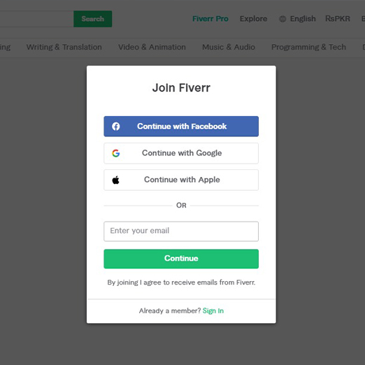
Create Your Account On Fiverr
Signing up on Fiverr is quite easy.
You can sign up through Google Account, Facebook Account, apple ID or simply by an email address.
Next you choose the username and password. But you also have an option to use your email address instead of your username.
After creating the account go to the inbox and activate it.

Slide 19
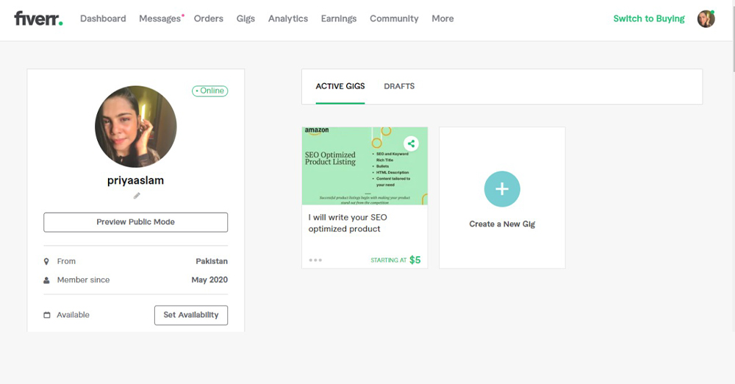
Set Up Your Profile
The profile plays a very crucial role as it directly has an impact on the client.
Your profile must be professional in every aspect, form picture to description everything needs to be top notch.
Add the right information and the right set of skills that you have to offer.
Mention the language or languages that you are proficient in, it attracts the right client.
Make sure your skills match your gigs. Mention your education background and then focus mainly on the certificates.
Your certificates help you stand out in the pool of your competitors. Once you’re done setting up your account you can create gigs on Fiverr.

Slide 20
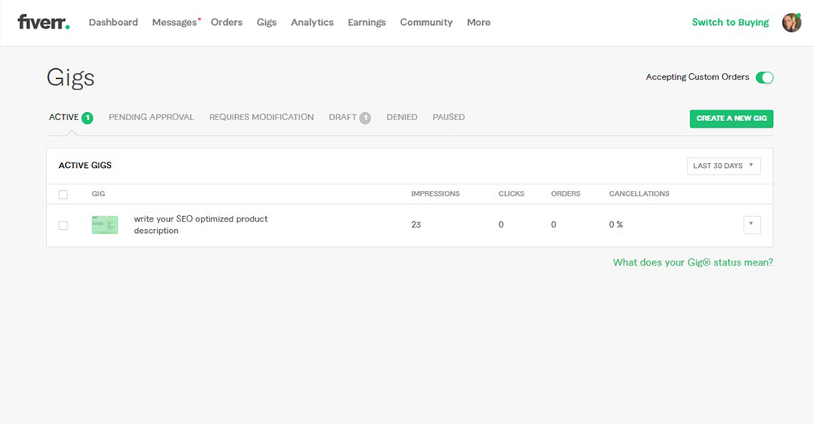
Create Gigs On Fiverr
Move your cursor to the selling option placed on the top of the bar and then click on “Gigs” option in the drop-down menu.
Click “Create the new Gig” button and now you can start working on it.

Slide 21
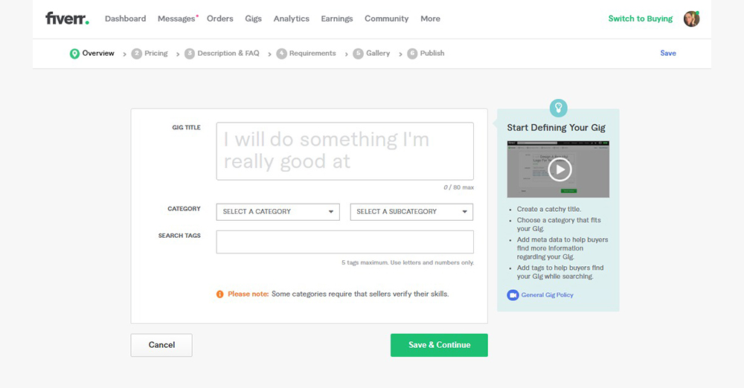
Create Gigs On Fiverr
Once you’ve got into the section of “Gig Overview” you’ve got to fill the title of your gig, select the right category (you have an option for category and subcategory) then mention related search tags in the last box.
The title should be original, concise and to the point. Do not forget to focus on selecting the category and sub-category. It is the most important part of creating gigs on Fiverr because it’ll predict your options in the next steps.
Selecting the category is not a hard task because Fiverr will automatically suggest the categories in which it falls based on the title that you’ve written above. You can simply select the category from the drop-down menu as well.
If you want to make your gig valuable, select the best search tags. If you want any help, search for the tags used by other sellers of your niche. It summarizes your expertise which helps to get the right client.
“Save and continue” to go on the next section.

Slide 22
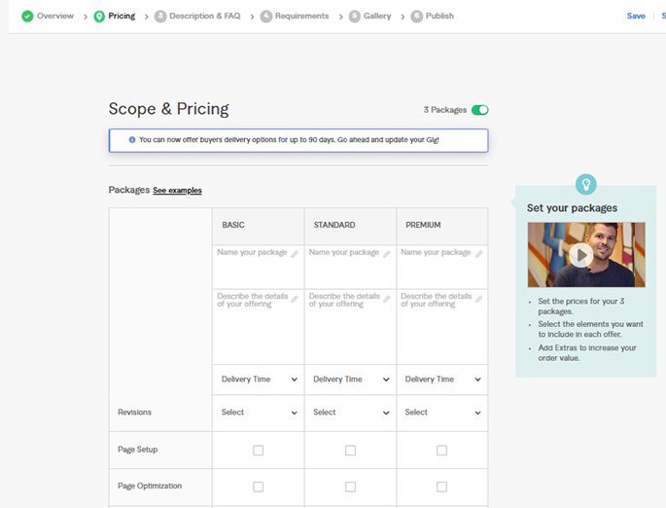
The Price Of Your Gigs
In this section you have the choice to set your own bid.
Here Fiverr offers three different kinds of packages i.e. Basic, Standard and Premium.
You can either go for all three options or one for all.
After that you need to give your package a title and description and make sure you’re creative because that it where the buyer will pay attention the most.
Mention the delivery time which will show the working days and also you can differ it with your pricing.
If you want, you can also fill the shipping section according to the location.

Slide 23
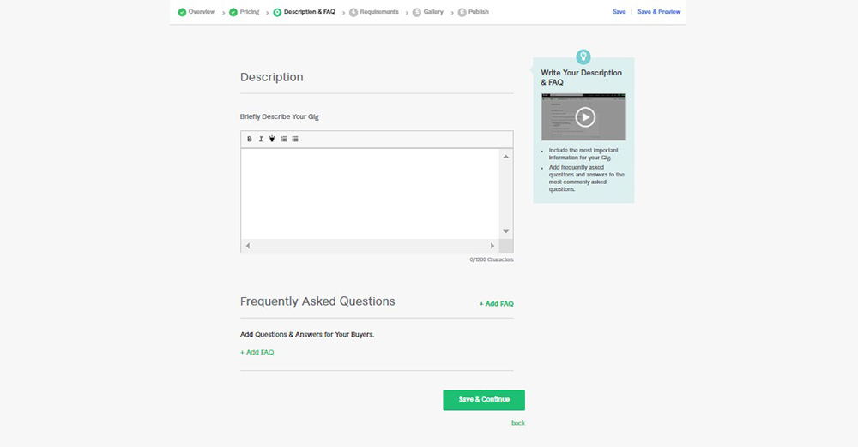
Mention Frequently Asked Questions (FAQ’s)
This option will lead you to a section of Frequently Asked Questions that may be revised with each project.

Slide 24
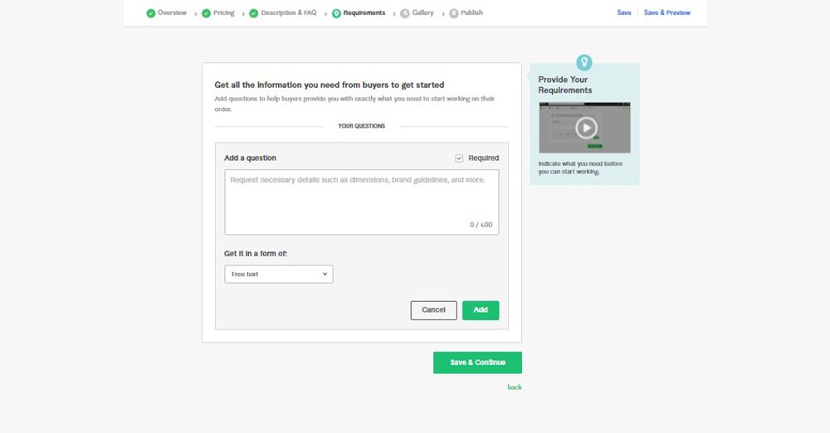
Your Requirements
Mentions all the requirements that you demand from the buyer’s community.

Slide 25
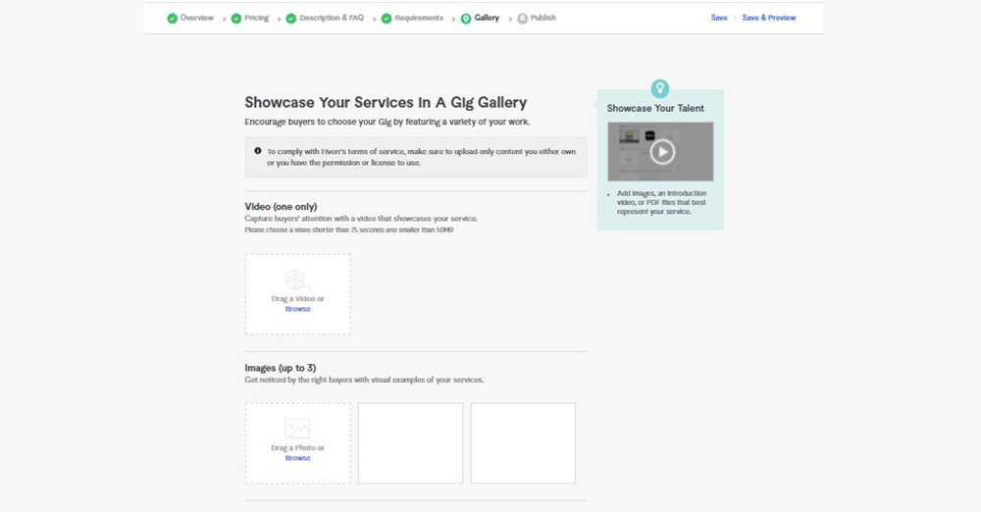
Make impactful Gigs Gallery Content
Your gig’s gallery will make a great impact on the clients. You can add photos, videos or pdfs in the content of gigs.
Publish Gigs And Go Live!
Now you can publish it! Click on “Publish Gig” option and the gig will go live.

Slide 26
Tutorial Setting up your Fiverr Profile

Slide 27
Setting up your Fiverr Profile
Are you a high school student looking to start freelancing on Fiverr? This tutorial will guide you step-by-step on creating your profile and setting up your gigs to begin your freelancing journey.
Step 1: Sign Up on Fiverr
1. Visit the Fiverr Website: Go to Fiverr's website at https://www.fiverr.com.
2. Sign Up: - Click on the 'Join' button in the top right corner. - You can sign up using your email address, Facebook, Google, or Apple ID.
3. Set a Username: Choose a professional and simple username that reflects your skills or services.
4. Create a Password: Use a strong and secure password.

Slide 28
Setting up your Fiverr Profile
Step 2: Complete Your Profile
1. Go to Your Profile Settings: - Once logged in, click on your profile picture or icon in the top right corner and select 'Profile'. 2. Upload a Profile Picture: - Choose a clear, friendly, and professional photo of yourself. 3. Write a Professional Description: - Introduce yourself. - Mention your skills and the services you offer. - Keep it concise and engaging. Example: 'Hi! I'm Alex, a high school student with a passion for graphic design. I specialize in creating logos, social media posts, and posters. Let's bring your ideas to life!' 4. Add Languages: List the languages you speak and your proficiency level. 5. List Your Skills: Add relevant skills, such as graphic design, writing, or video editing. 6. Link Your Social Accounts (Optional): If you have a LinkedIn or social media account showcasing your work, link it here.

Slide 29
Setting up your Fiverr Profile
Step 3: Create Your First Gig
1. What is a Gig? A gig is the service you offer on Fiverr. Each gig should focus on one skill or service. 2. Click on 'Create a New Gig': - Navigate to your dashboard and click 'Gigs' → 'Create a New Gig'. 3. Fill in Gig Details: - Title: Create a catchy and clear title. Example: 'I will design a creative logo for your business.' - Category: Choose a category that best fits your gig (e.g., Graphic Design, Writing, Digital Marketing). - Search Tags: Add keywords people might use to find your service (e.g., 'logo design,' 'creative logo').

Slide 30
Setting up your Fiverr Profile
Step 3: Create Your First Gig
4. Describe Your Service: - Write a detailed description of what you offer. - Include examples of your work, if possible. Example: 'I will design a professional logo tailored to your needs. I offer up to 3 revisions to ensure you are satisfied with the result.' 5. Set Pricing: Choose a basic price that fits your experience (e.g., $5-$10 for starters). Offer additional services or faster delivery for higher prices. 6. Upload Portfolio Samples (Optional): Add examples of your work to showcase your skills. 7. Publish Your Gig: After completing the setup, click 'Publish' to make your gig live.

Slide 31
Setting up your Fiverr Profile
Step 4: Build Your Reputation
1. Promote Your Gig: - Share your gig link on social media platforms or with friends and family. 2. Respond Quickly to Messages: - Be professional and polite when interacting with potential buyers. 3. Deliver High-Quality Work: - Ensure your work meets or exceeds client expectations. - Deliver on time. 4. Request Reviews: - Politely ask your clients to leave a review after completing a project.

Slide 32
Setting up your Fiverr Profile
A portfolio is a showcase of your skills and past work, which helps potential clients trust your abilities. Follow these steps to create a strong portfolio for your Fiverr profile:
Identify Your Skills:
List the services you plan to offer, such as graphic design, writing, or web development.
Focus on your strongest and most marketable skills.
Create Sample Work:
If you don't have previous projects, create mock examples related to your services.
For example, design a logo for a fictional company or write a sample blog post.
Use Free Tools (If Needed):
Utilize free tools to create high-quality work, such as Canva for design, Google Docs for writing, or Figma for UI/UX design.
Ensure your samples are visually appealing and error-free.

Slide 33
Setting up your Fiverr Profile
Upload Your Portfolio to Fiverr:
Go to your Fiverr profile settings and navigate to the portfolio section.
Upload your samples with a clear title and description.
Highlight what makes each sample unique or valuable.
Keep Updating Your Portfolio:
As you complete more projects on Fiverr, update your portfolio with new examples.
Remove older samples that no longer represent your best work.
Include a Variety of Work:
Show diversity in your samples to appeal to a broader audience.
For example, if you're a graphic designer, include logos, banners, and social media posts
Use Descriptions Effectively:
Write a brief description for each portfolio item, explaining its purpose and how it solves client problems.
Mention the tools or methods you used.

Slide 34
Tips for High School Freelancers
- Start Small: Offer simple and affordable services to build your reputation. - Be Honest: Clearly communicate your skills and avoid over-promising. - Learn Continuously: Take free courses or watch tutorials to improve your skills. - Stay Safe Online: Do not share personal information with clients.

Slide 35
Setting up your Fiverr Profile( In a Nutshell)
Add your Profile picture: ...
Provide a "one-liner" about your business: ...
Fill in your education details: ...
Provide your certifications: ...
Add your description: ...
Tag your most relevant skills, based on the service you provide: ...
Add your Top clients: ...
Add your portfolio:

Slide 36
Step-by-Step Guide to Setting Up a LinkedIn Profile

Slide 37

Step-by-Step Guide to Setting Up a LinkedIn Profile
Step 1: Sign Up for LinkedIn
Visit the LinkedIn website at www.linkedin.com.
Click on the Join Now button.
Enter your details:
First and Last Name
Email Address
Create a Strong Password
Click Agree & Join

Slide 38
Step-by-Step Guide to Setting Up a LinkedIn Profile
Step 2: Add Your Profile Picture
Choose a professional headshot or a clear photo where you’re dressed appropriately.
Upload the image by clicking on the photo icon in the profile section.
Ensure the photo is high-quality and has a neutral background

Slide 39
Step-by-Step Guide to Setting Up a LinkedIn Profile
Step 3: Enter Your Headline
Your headline appears below your name.
Write a short, compelling statement summarizing your skills or aspirations.
Example: “High School Student | Aspiring Graphic Designer | Freelance Writer.”

Slide 40
Step-by-Step Guide to Setting Up a LinkedIn Profile
Step 4: Fill Out Your Summary
Scroll to the About section and click Add Summary.
Write a short paragraph (100-200 words) about yourself, focusing on:
Your goals
Key skills
Experience or projects
End with a call-to-action, like:
“Feel free to connect with me for collaboration opportunities!”

Slide 41
Step-by-Step Guide to Setting Up a LinkedIn Profile
Step 5: Add Your Education Details
Go to the Education section and click Add Education.
Fill in:
School Name
Degree (e.g., High School Diploma)
Field of Study (if applicable)
Start and End Dates
Optionally, add activities, awards, or notable projects.

Slide 42
Step-by-Step Guide to Setting Up a LinkedIn Profile
Step 6: Highlight Your Skills
Scroll to the Skills section and click Add a Skill.
Add at least 5-10 skills related to your field.
Examples:
Communication,
Teamwork,
Graphic,
Design.
Writing Endorsements will strengthen this section over time

Slide 43
Step-by-Step Guide to Setting Up a LinkedIn Profile
Step 7: Include Work Experience or Volunteering
Go to the Experience section and click Add Experience.
If you have work experience or volunteering, include:
Job Title
Organization Name
Dates of Employment
Key Responsibilities and Achievements
For students, list part-time jobs, internships, or school projects.

Slide 44
Step-by-Step Guide to Setting Up a LinkedIn Profile
Step 8: Build Your Network
Use the Search Bar to find classmates, teachers, or professionals in your field of interest.
Click Connect to send an invitation.
Write a short, polite note with your connection requests, like:
“Hi [Name], I’m excited to connect with you as I build my professional network!”

Slide 45
Step-by-Step Guide to Setting Up a LinkedIn Profile
Step 9: Follow Relevant Pages
Follow companies, industry leaders, or organizations related to your field.
Engage with their posts to stay updated and showcase your interest.
Step 10: Regularly Update Your Profile
Add new experiences, certifications, or skills as you gain them.
Post about your achievements or share articles relevant to your field

Slide 46
Thank you
Mr Khurram Iqbal,
COMSATS University, Islamabad.
Khurram.Iqbal@comsats.edu.pk

